Slide 1




The Right to Safe Mobility for Children & Adolescents
Atsani Ariobowo
Director Child & Youth Health
FIA Foundation

Slide 2


The Problem
Road crashes is still the #1cause of death for children and young adults aged 5-29 years
Globally, a child dies every 3 minutes due to road crashes, or approximately 227,000 every year
Notes:
[Slides 1,2] – To set the scene again, as Natalie has fittingly described, we have a crisis on our hands where road crash is the leading cause of death for adolescents and youth. We sometimes refer to it as the disease of the young.

Slide 3





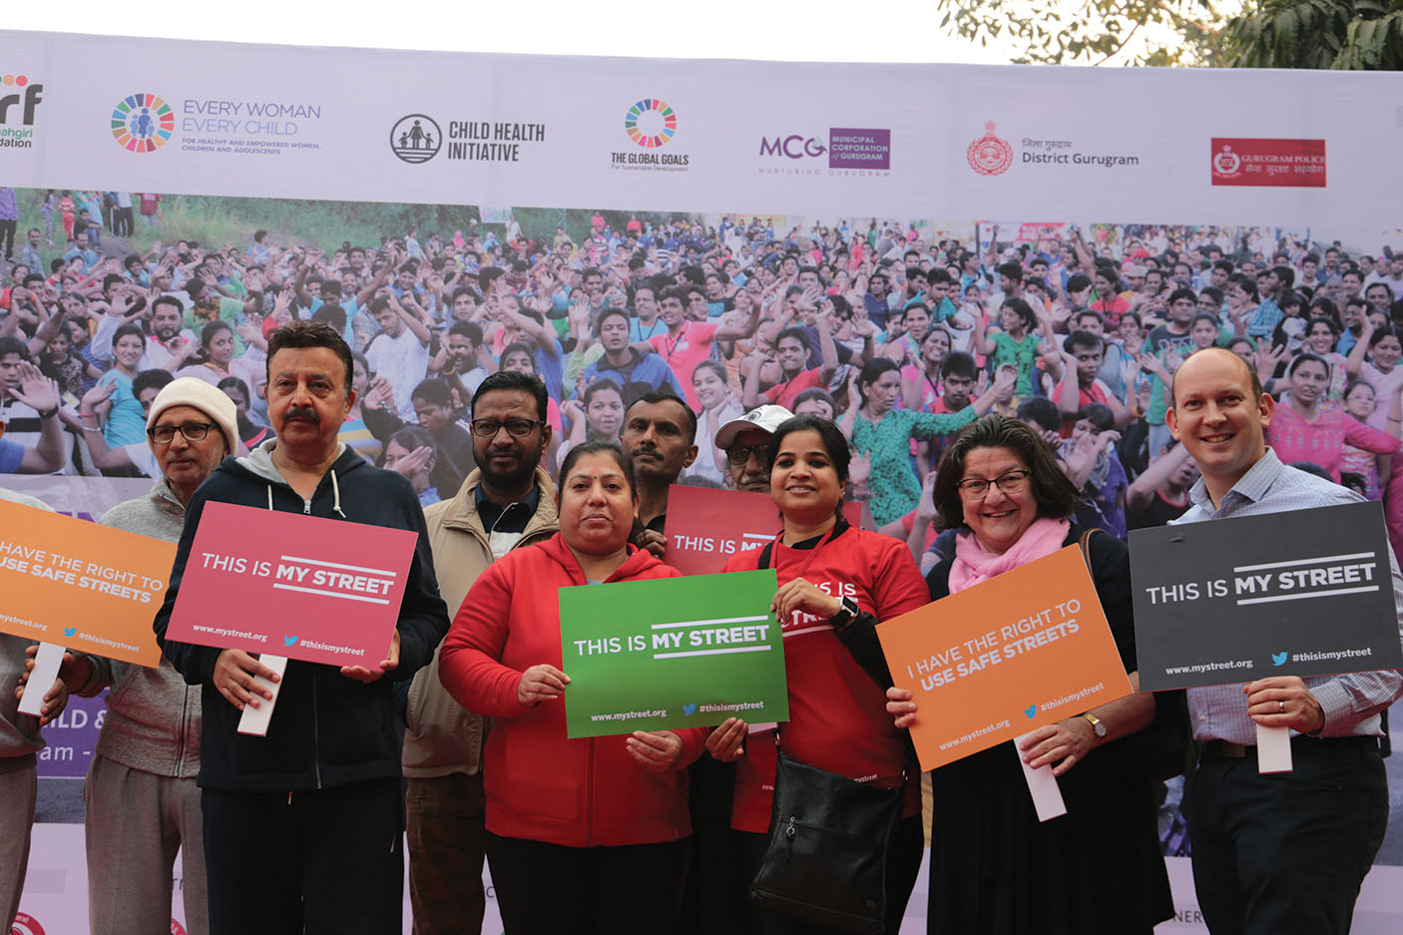
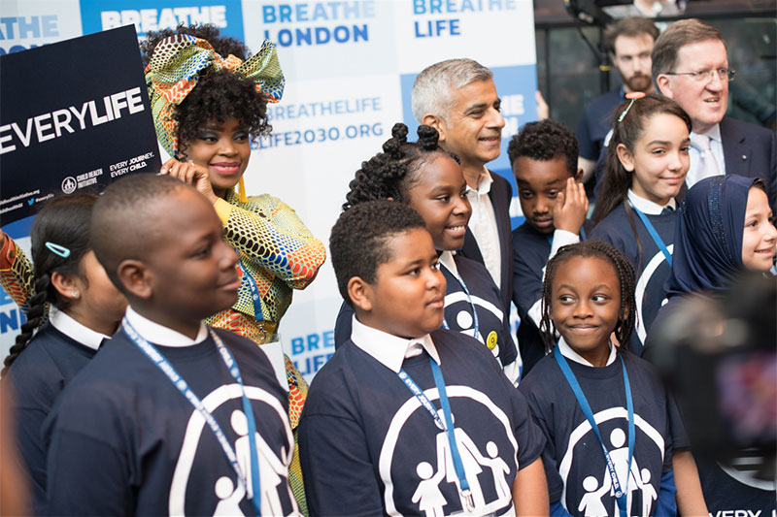



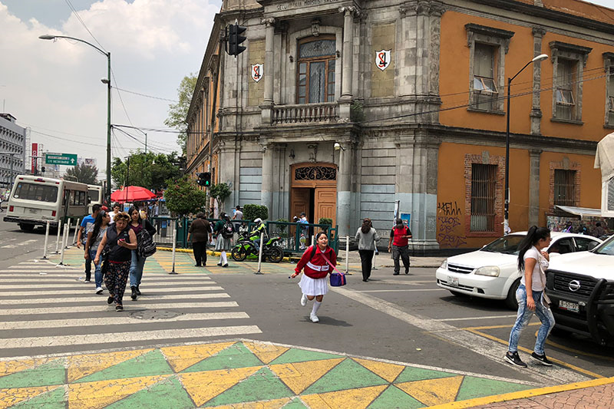


Slide 4
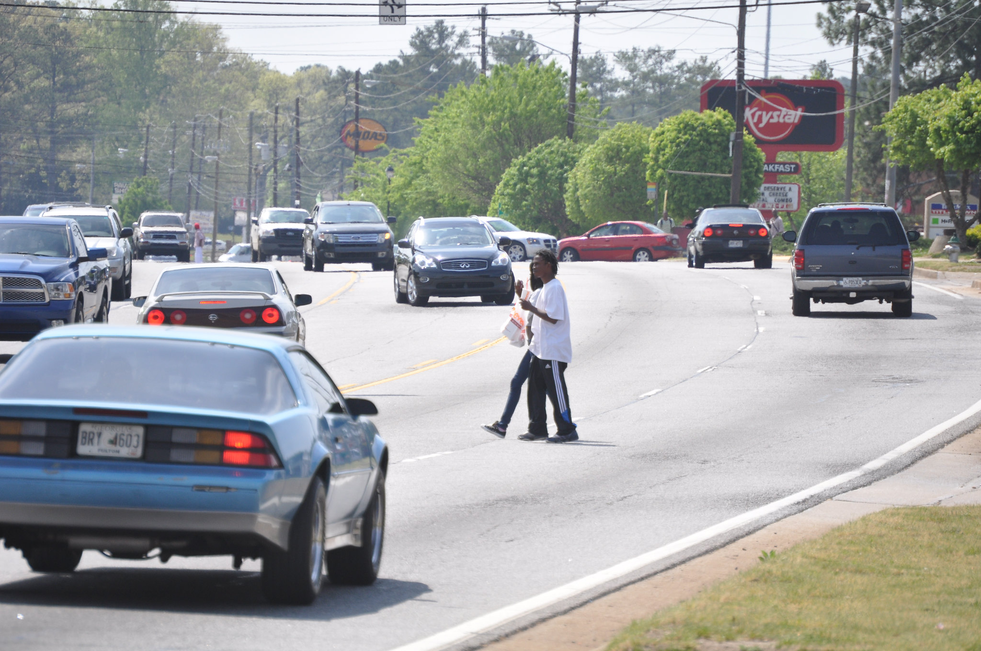

Source: iRAP Safety Insights Explorer
Image: Flickr / Transportation for America / Stephen Lee Davis

Slide 5
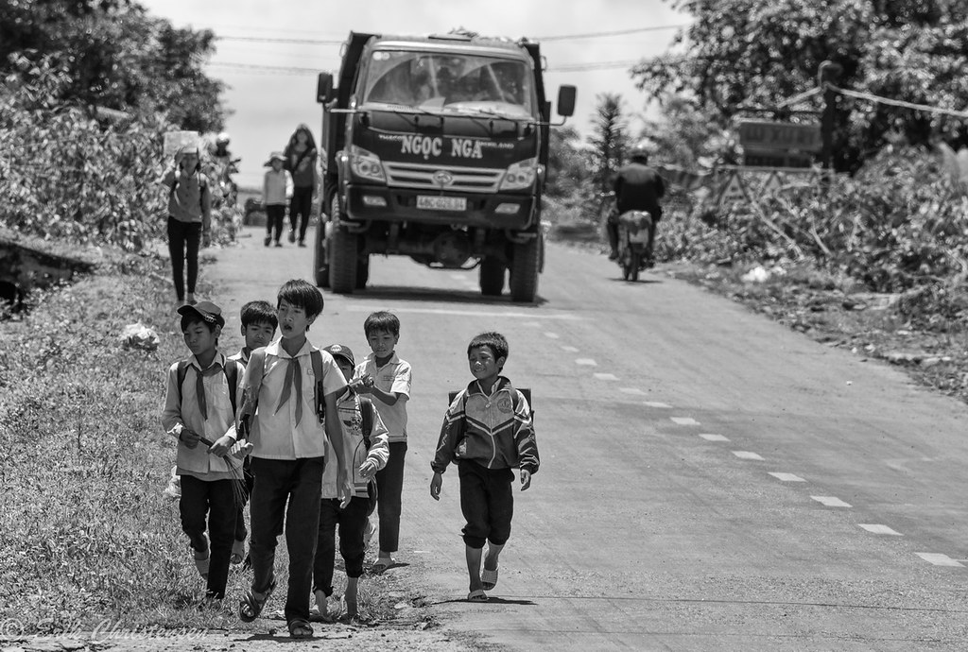
Source: AIP Foundation
Image: Flikr/Erik Christensen

Slide 6
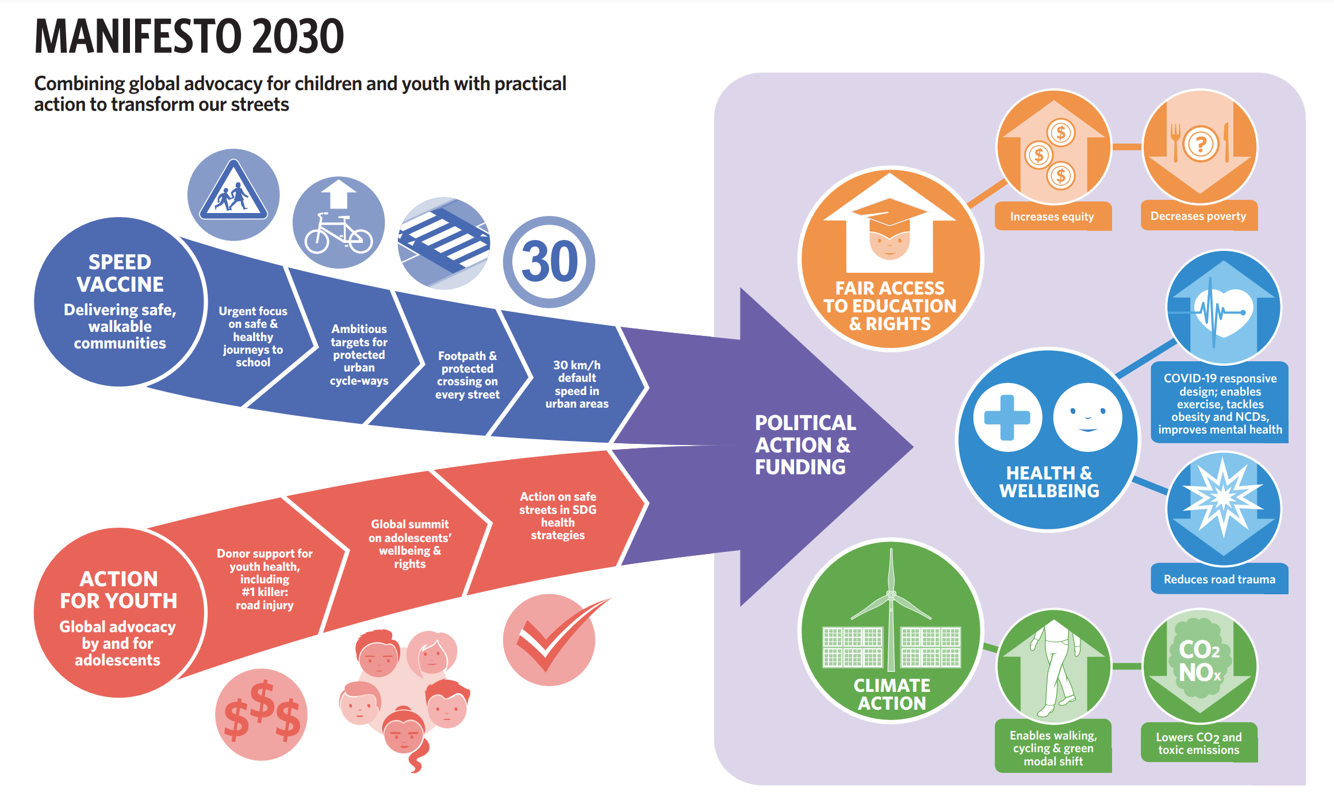

Slide 7
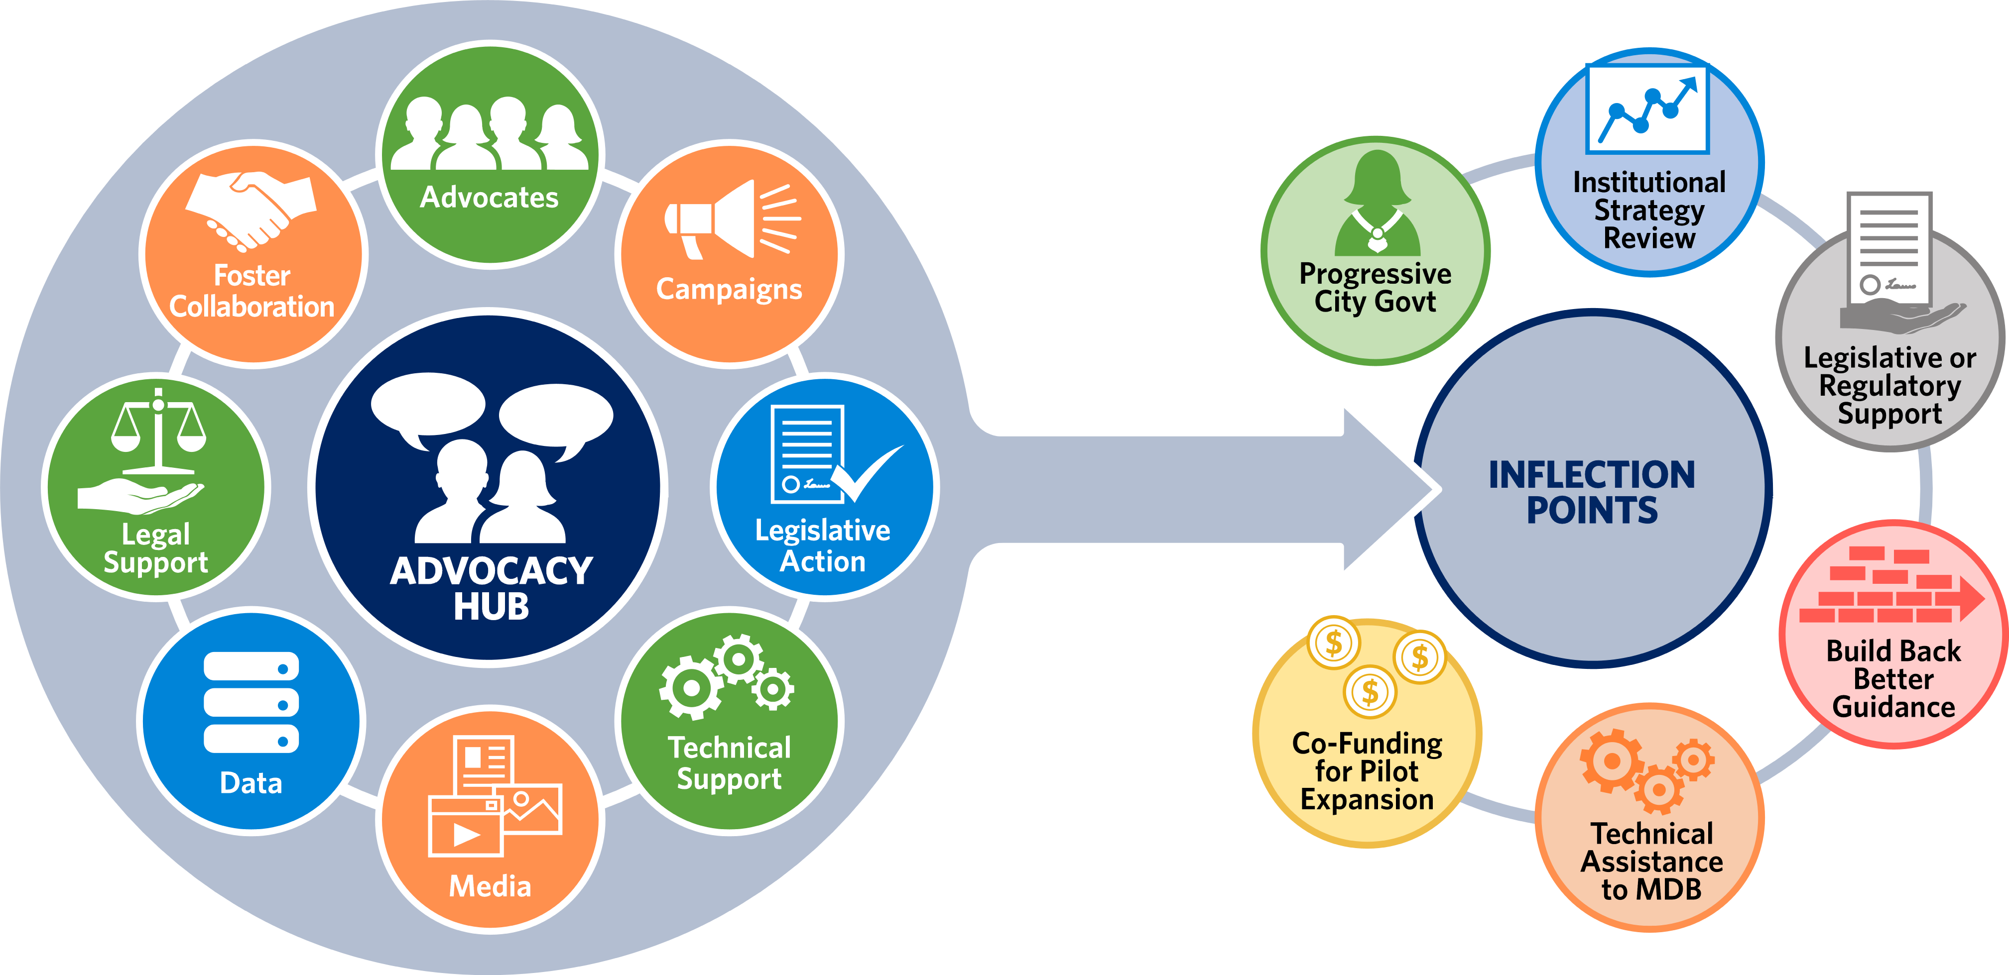

Slide 8
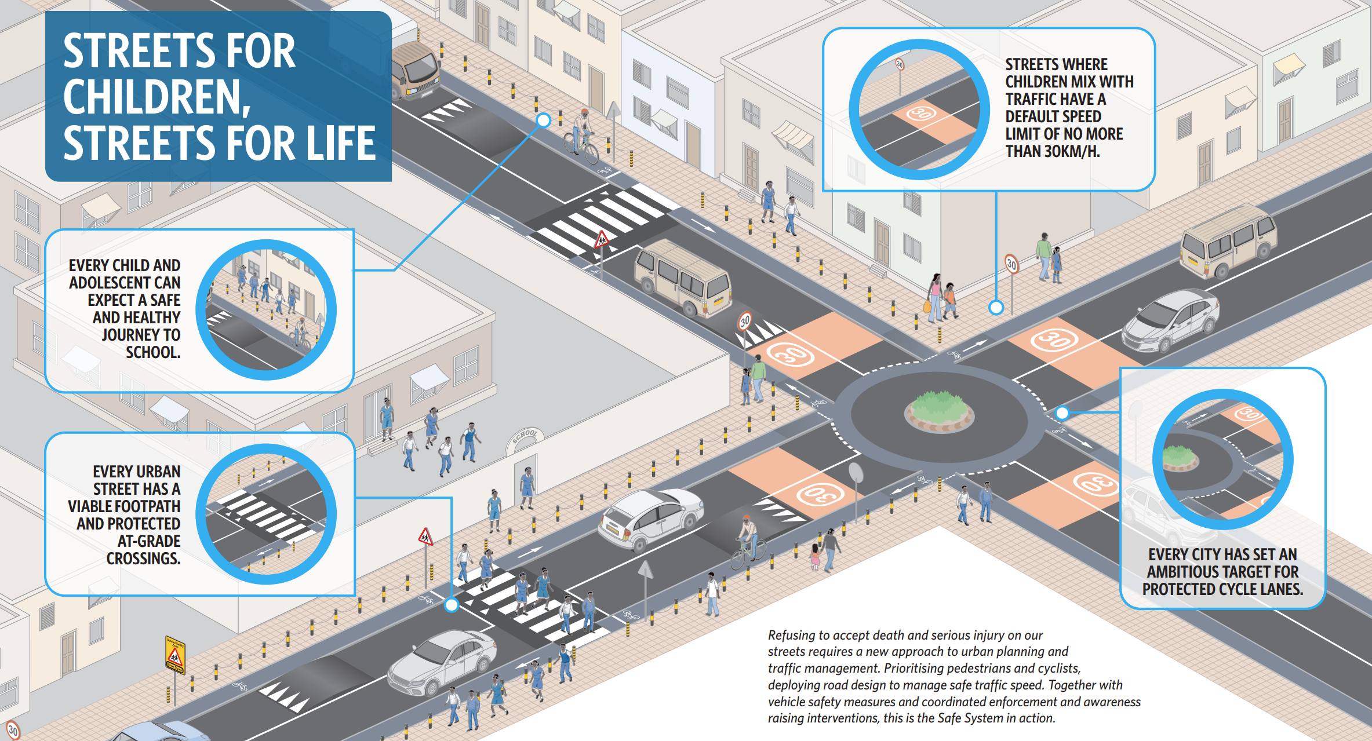

Slide 9
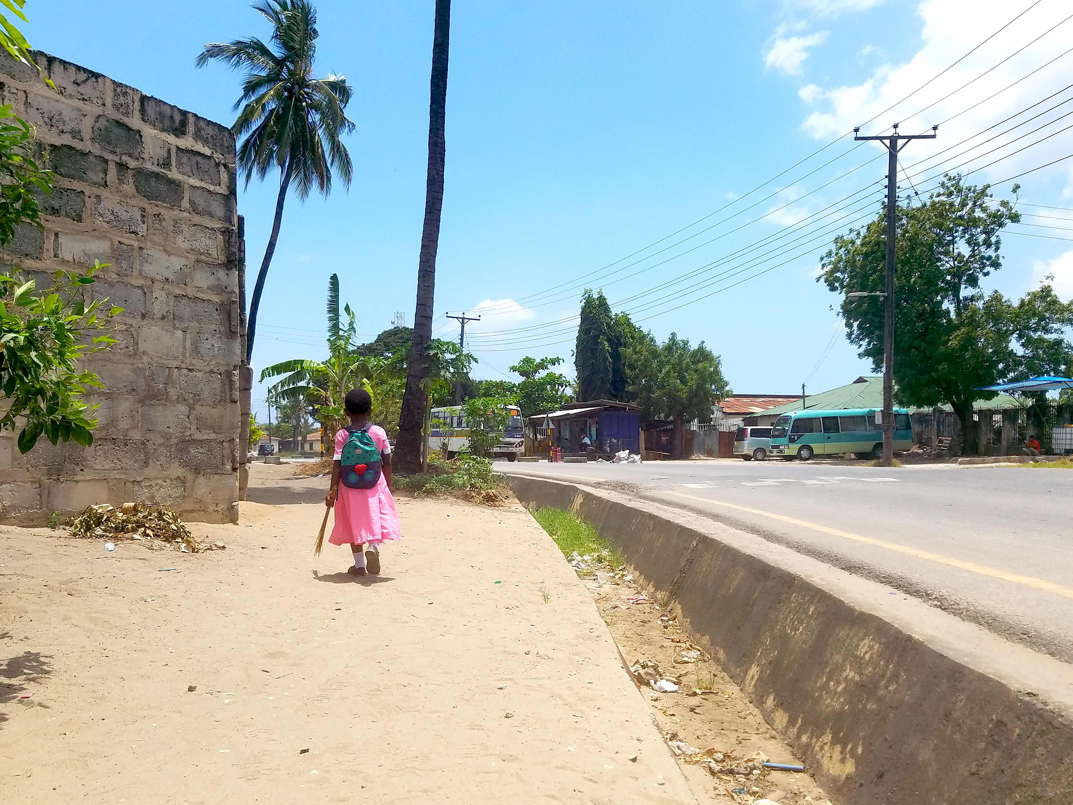
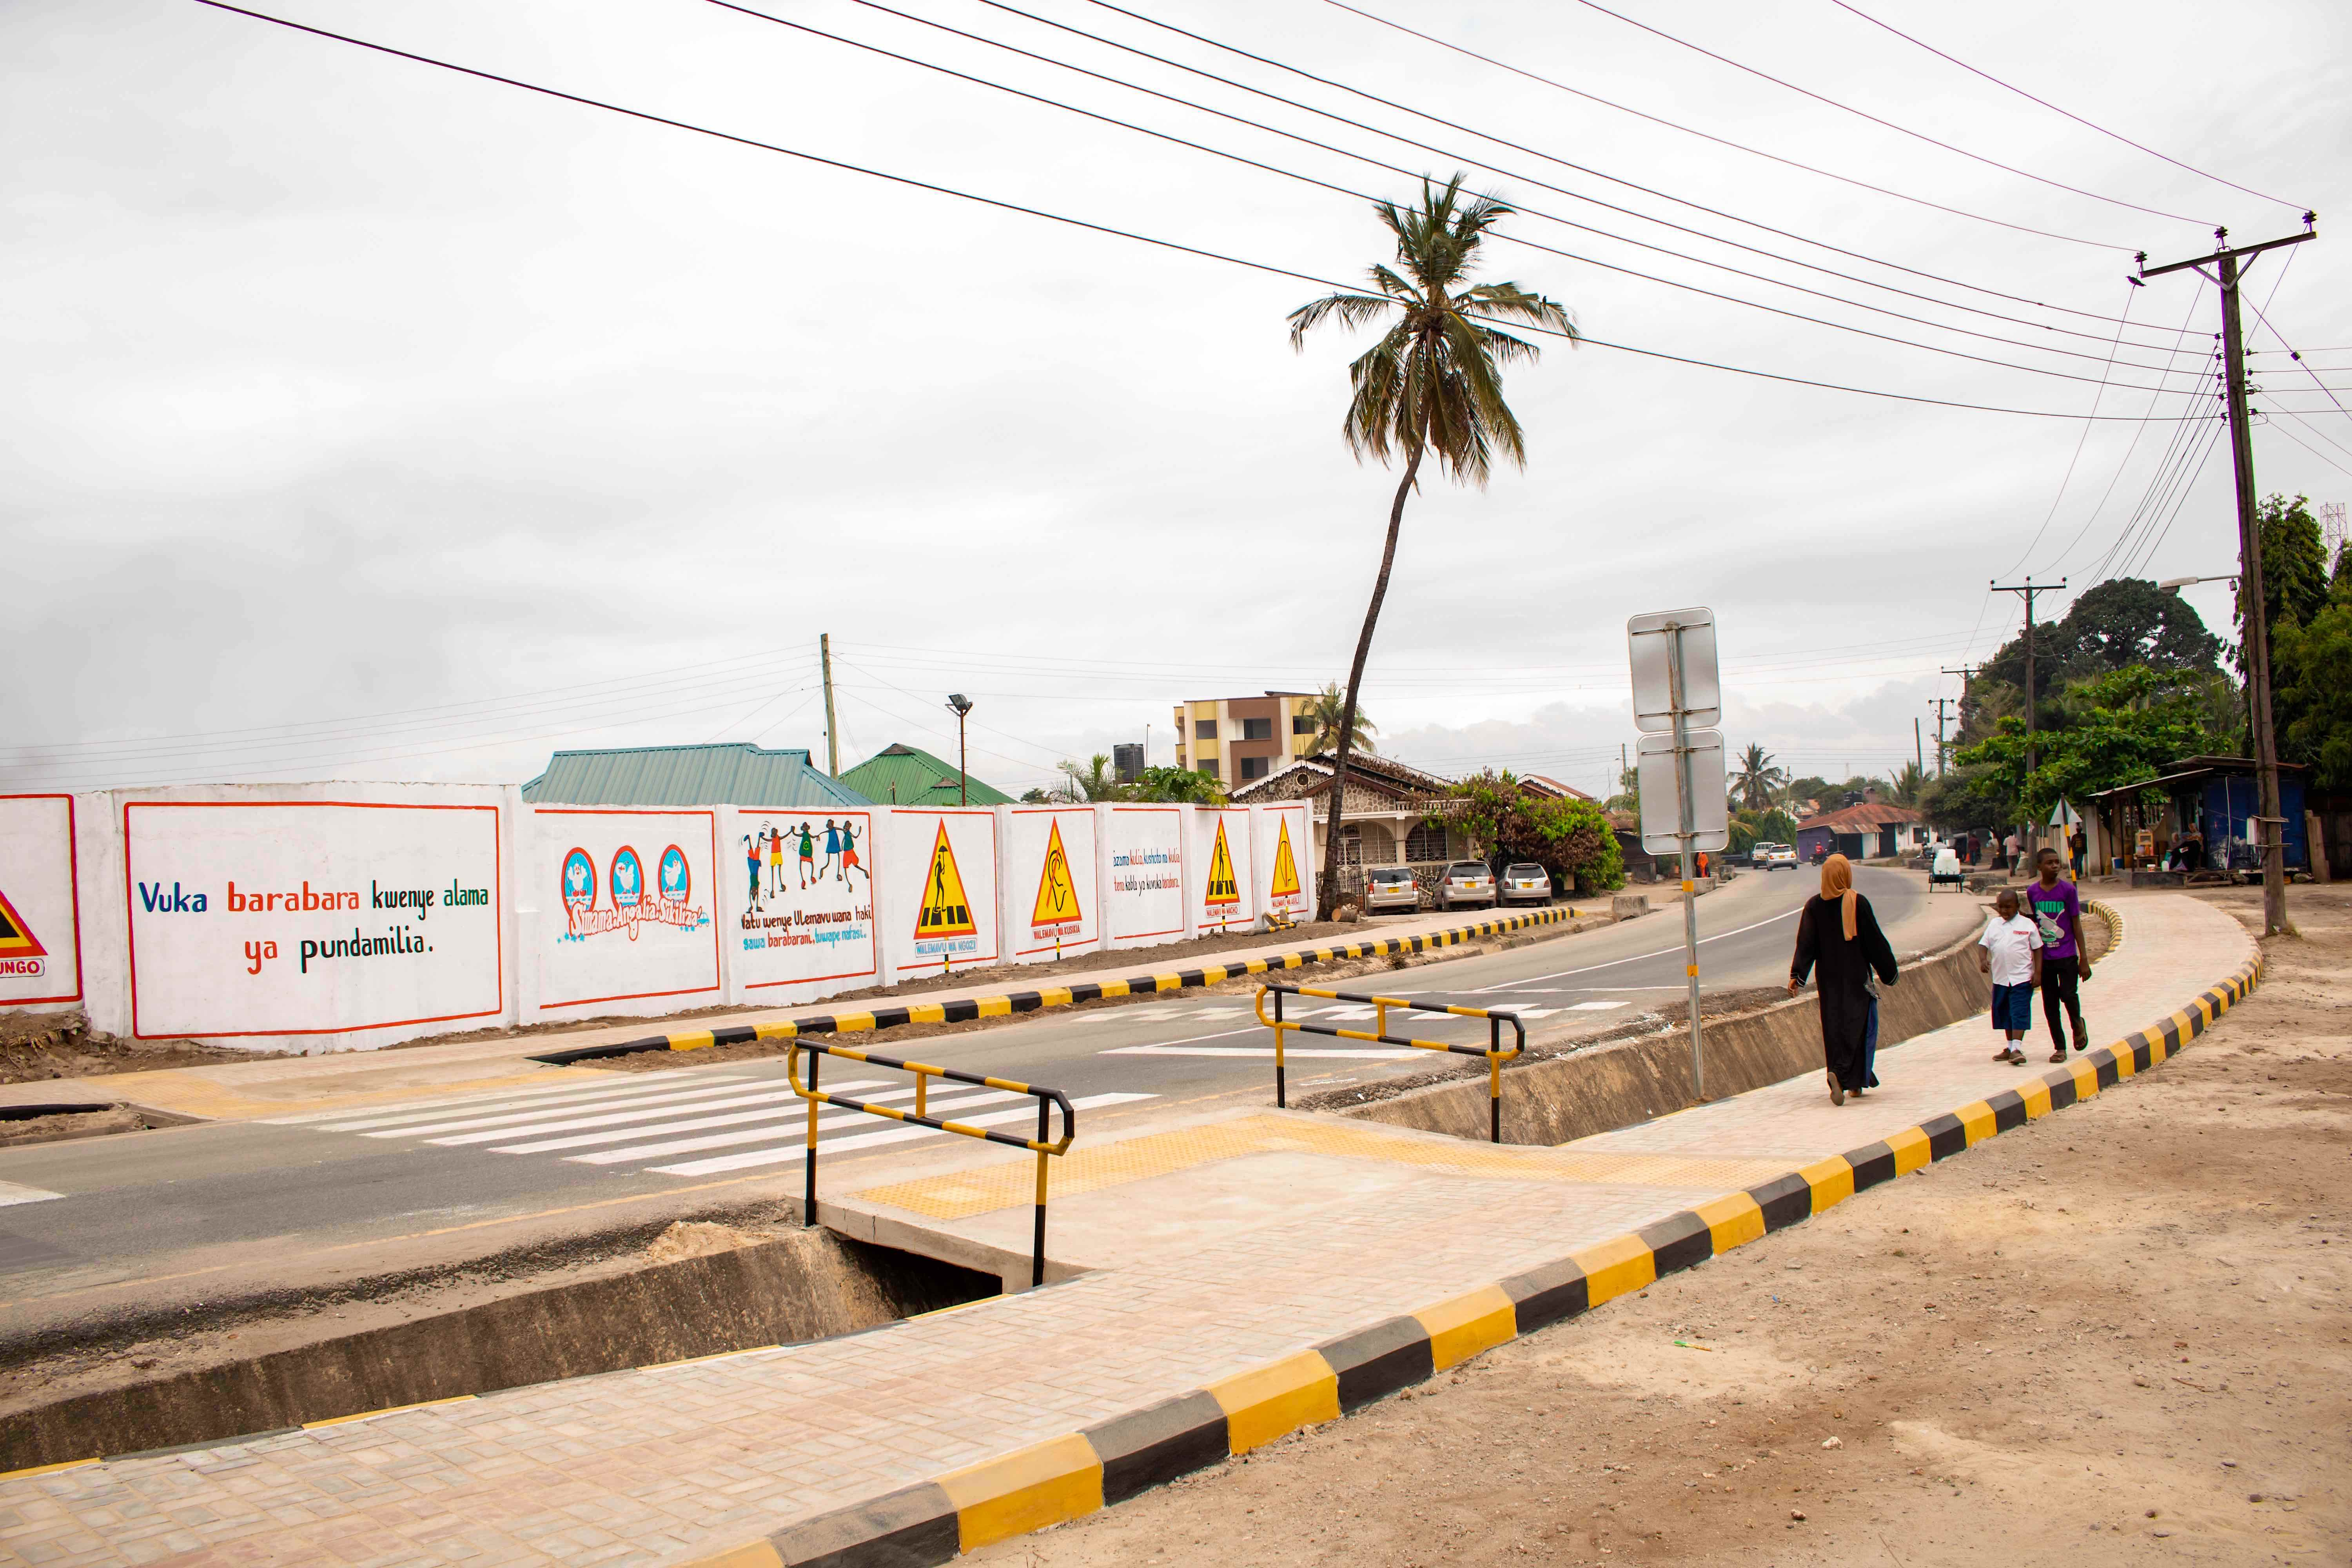

Before
After

Slide 10
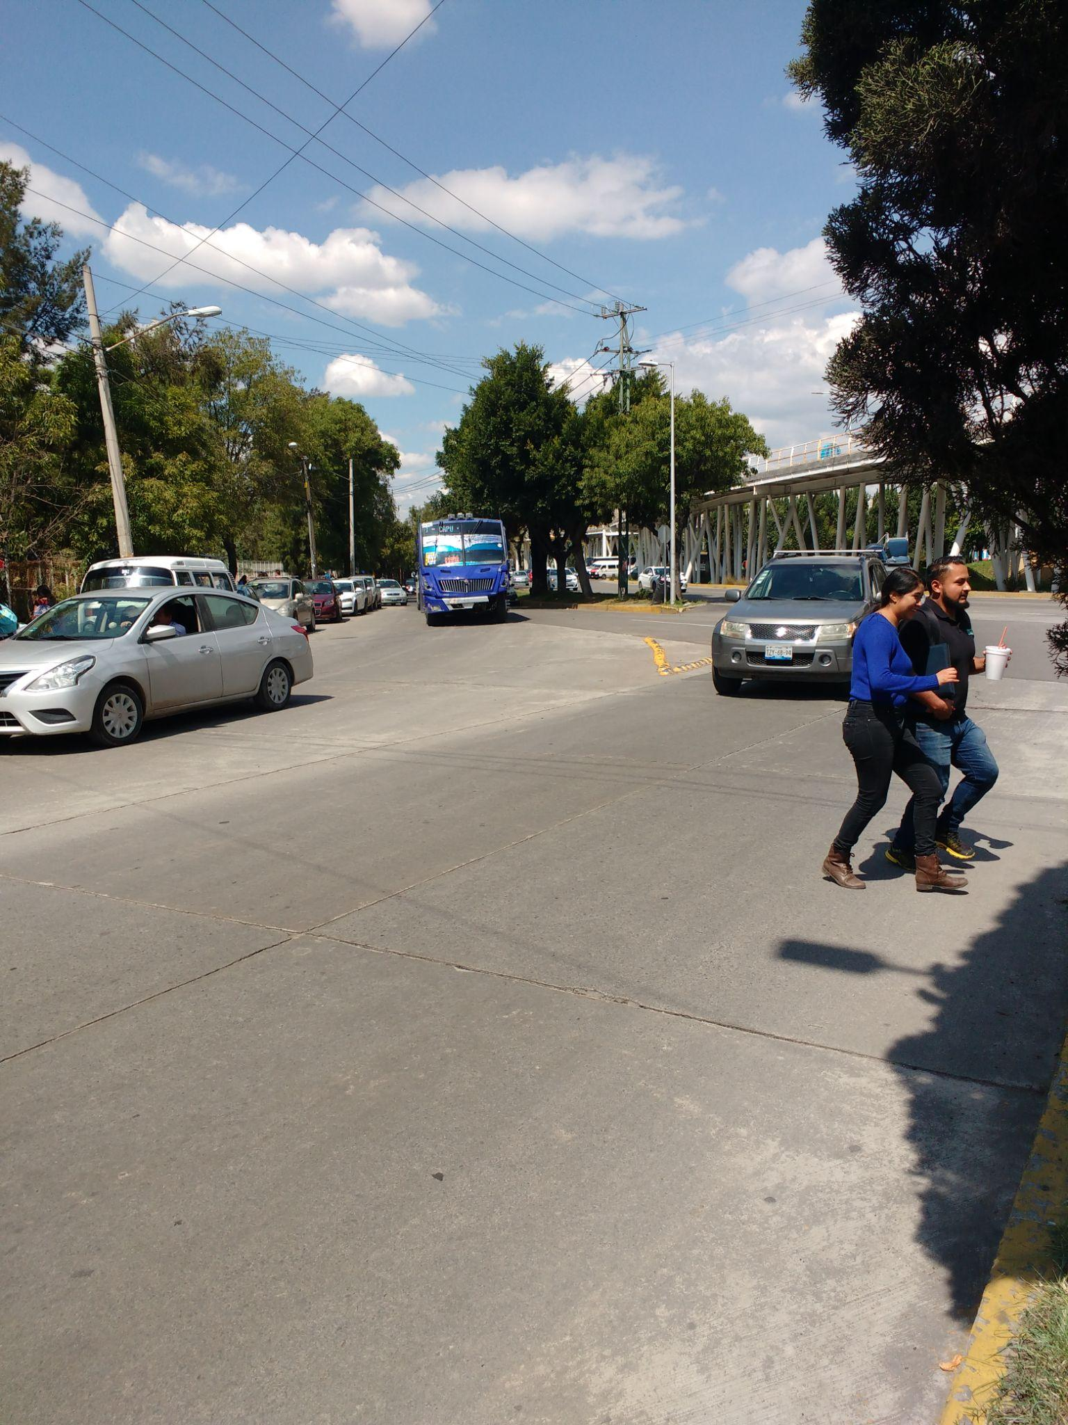
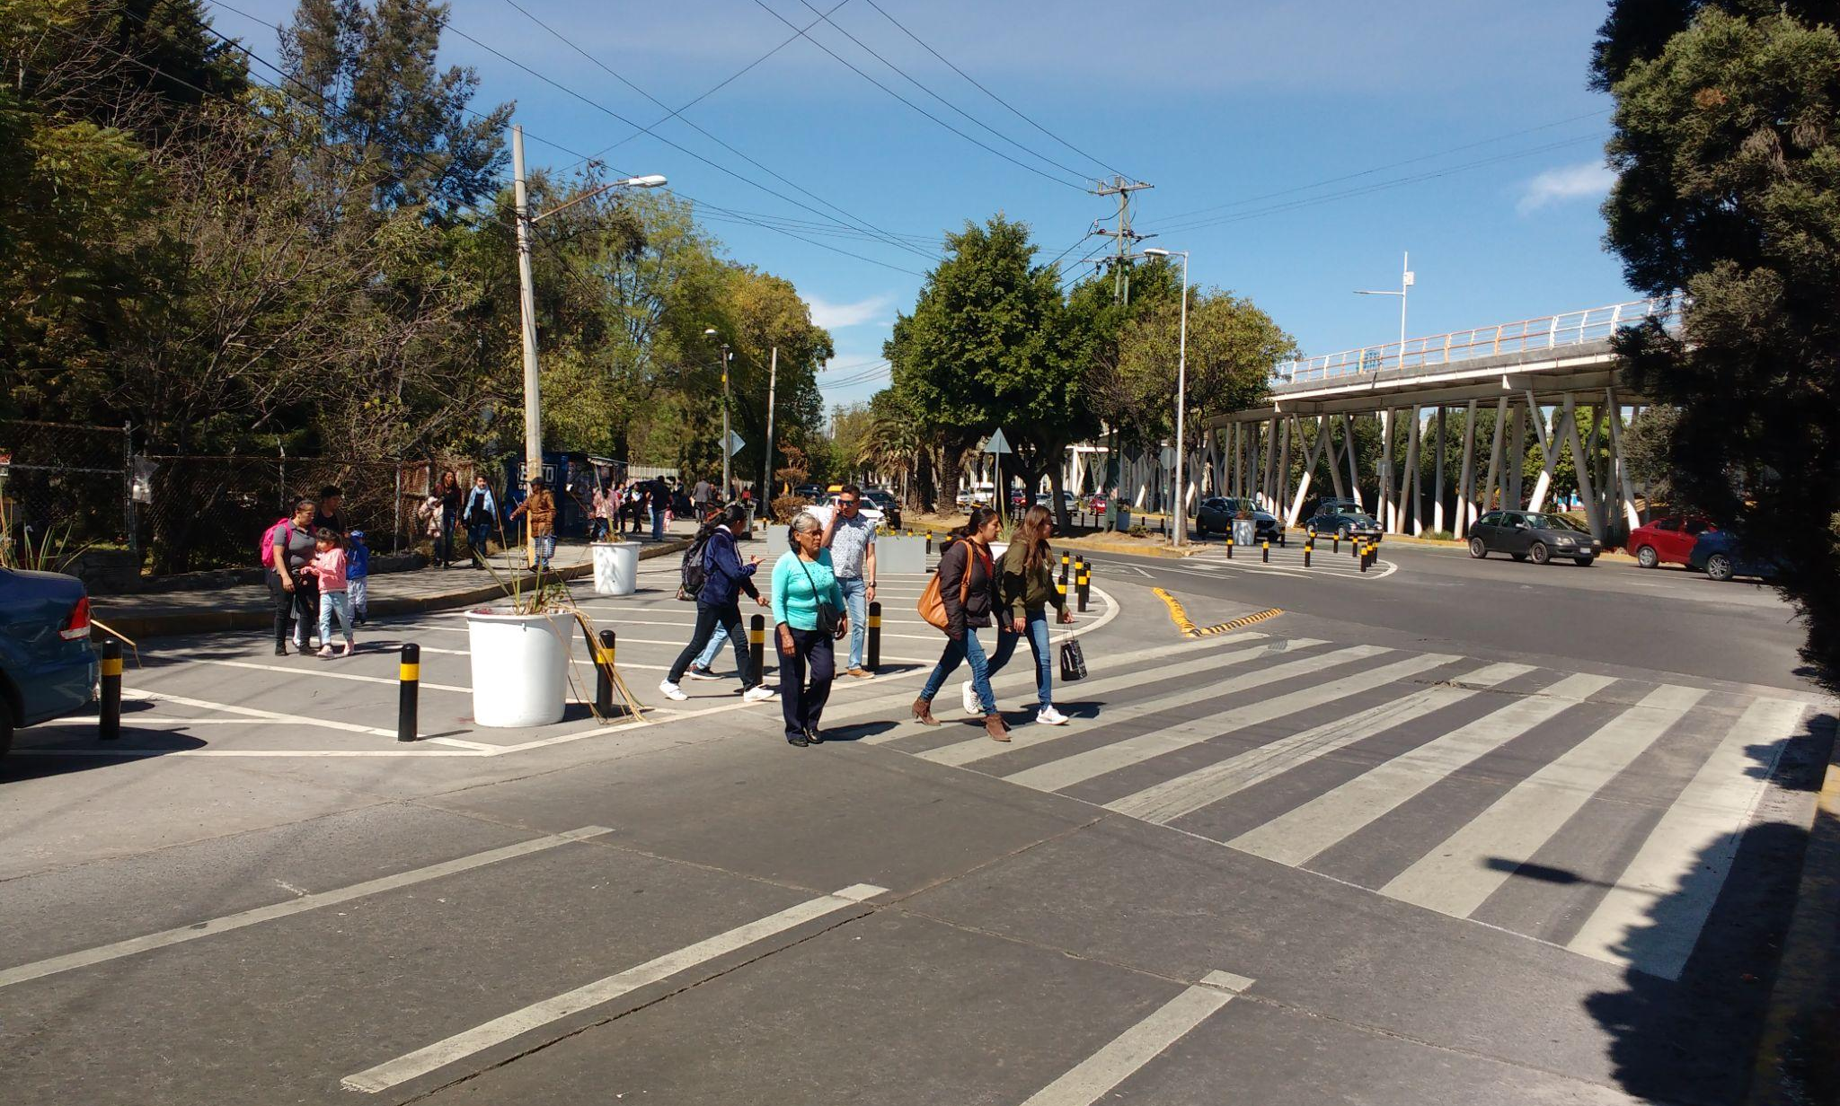

Puebla, Mexico: 69% reduction in conflict
Before
After

Slide 11
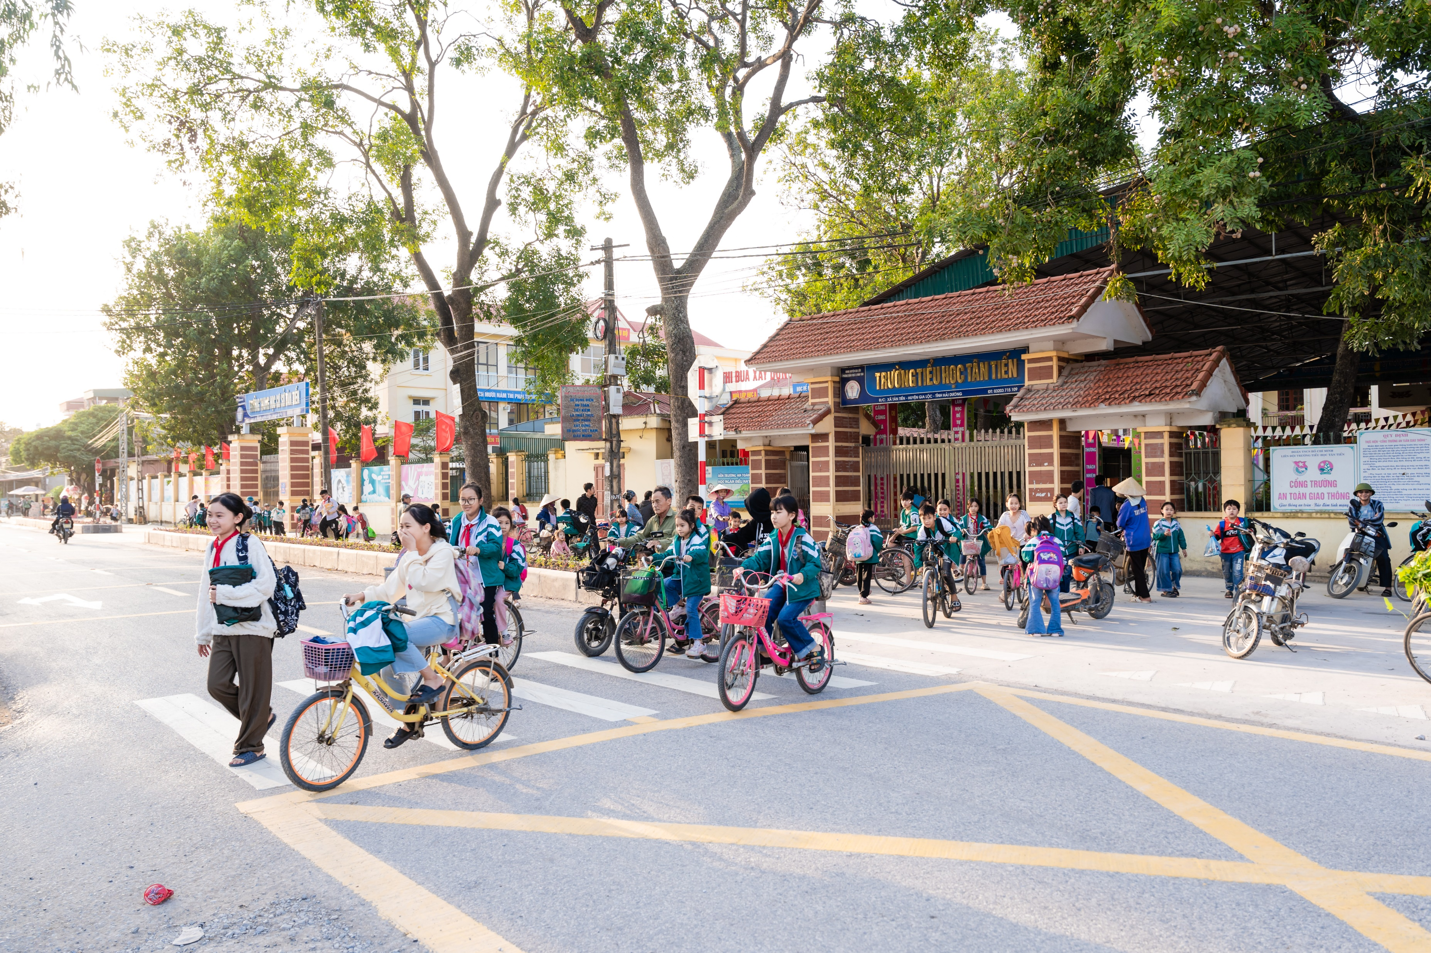

After

Slide 12
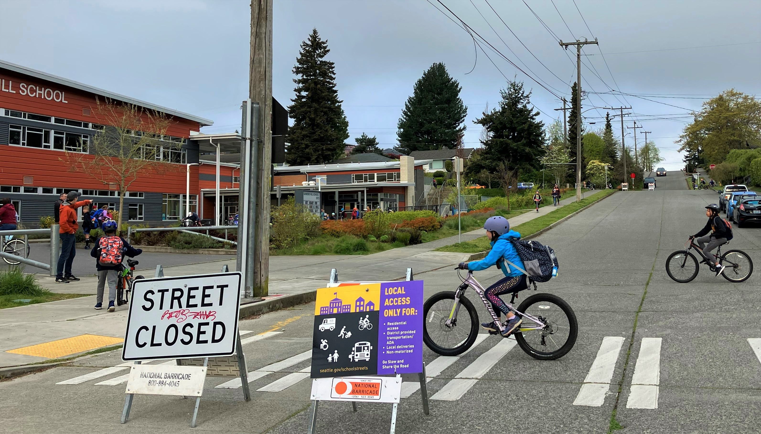

Slide 13
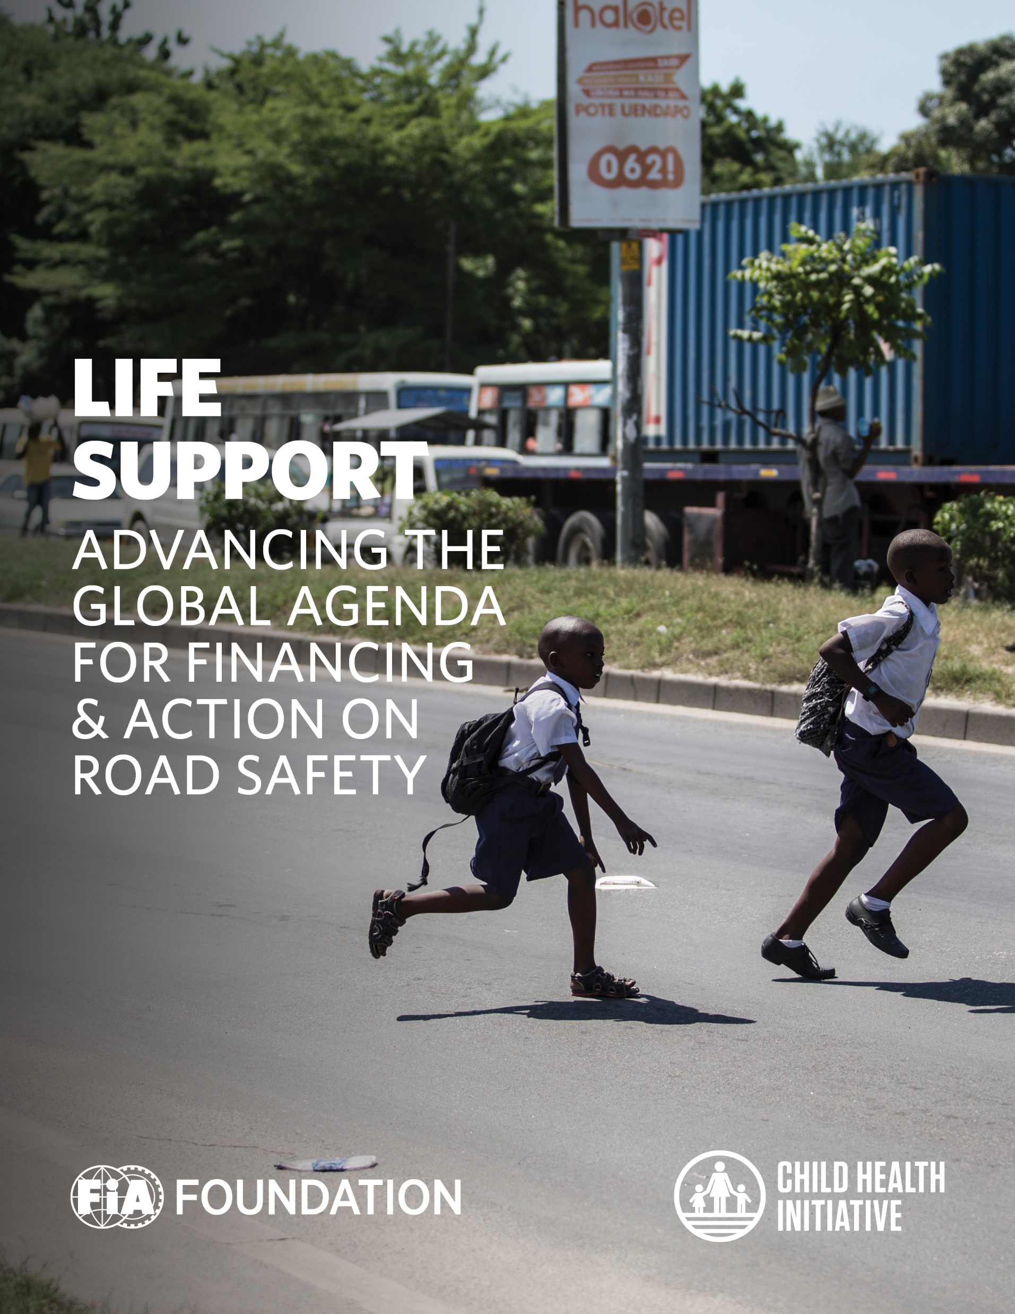


Slide 14
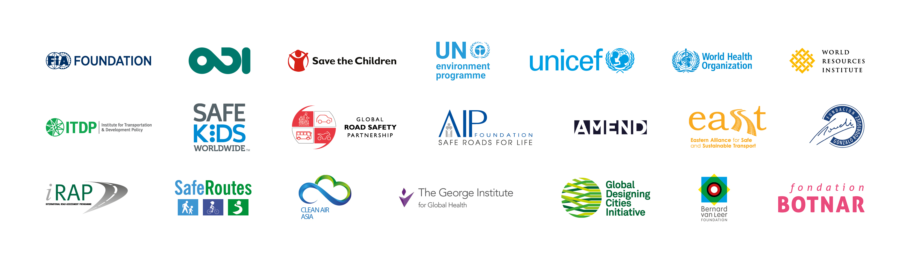
This is us

Slide 15
MUCHAS GRACIAS!
Atsani
a.ariobowo@fiafoundation.org

